Slide 1
Databases and the Web IS53064A
Lecture 1.1
Module Overview

Slide 2
In Dynamic Web Applications…
Recap

Slide 3
HTTP (Hyper Text Transfer Protocol)
Examining the HTTP request in more detail
Client
Web Server
Web Site or Web App
REQUEST
Resources
RESPONSE
Building a few of these is what you will do in the labs
It’s a conversation between the client, running your browser, and the web server, running your web site or web app.
REQUEST
Other
Resources
RESPONSE
Understanding how this conversation works is the key thing for this module!
…
Notes:
The client (i.e. web browser) makes a request for a particular resource. Scripts on the server evaluate the request and return a response (which may or may not include the requested resource, plus some other stuff...) The web browser will evaluate the response and decide what to display and how to display it.

Slide 4
3-Tier web architecture Alternative Terminology
Front-End
Middleware
Back-End

Slide 5
HTTP Request Methods
Sometimes called “verbs”
Requests data from the server
GET
HEAD
Submits data to the server (often from
an HTML form)
POST
CONNECT
PUT
OPTIONS
DELETE
TRACE
Notes:
The main HTTP request methods to be aware of are GET and POST.

Slide 6
Drilling into a REQUEST and RESPONSE
The request and response are made up of a number of parts
REQUEST
Request
Method
GET
Header
URL: www.mysite/about
+ other stuff
Response
Status
200
Body
Header
Content-Type: text/html; charset=utf-8
+ other stuff
Body
<h1>About page</h1>
RESPONSE

Slide 7

Node.js modules
Node.js has a set of built-in modules which you can use without any further installation.
https://www.w3schools.com/nodejs/ref_modules.asp
To include a module, use the require() function with the name of the module:
var http = require('http');
There are also third-party extension modules that can be added:
var express = require('express');

Slide 8

What is Express?
Express is a Node.js web application framework
It is lightweight. It doesn’t enforce a strict way of working.
It is extendable. We can plug in extensions.
It makes coding our node.js applications simpler

Slide 9
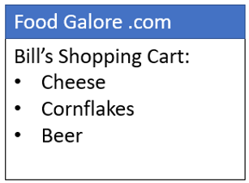
Filling in an EJS template
cart.html
<h1><%=customer%> shopping cart</h1> <ul> <%for (var i=0;i<products.length; i++){%> <li> <%=products[i]%> </li> <%}%> </ul>
data
+
customer=Bill
products = [‘Cheese’,’Cornflakes’,’Beer’]
=

Slide 10
Data Models
When we think about how to represent the data for a particular business scenario, we are thinking about data modelling
We specify the entities and the relationships between them
For each entity we specify the fields
Customers
ID
Customer Name
Address
Purchases
Date
Drink Purchased
Quantity Purchased
Price
Customer ID
Shop ID
Shops
ID
Shop Name
Shop Address
This is called an Entity-Relationship or ER model

Slide 11
Primary and Foreign Keys
Primary keys are unique in each table. They uniquely identify a row in the table.
Customers
ID
Customer Name
Address
This ID is a unique value for each customer
Purchases
Date
Drink Purchased
Quantity Purchased
Price
Customer ID
Shop ID
Shops
ID
Shop Name
Shop Address
This ID is a unique value for each shop

Slide 12
Normalisation
The process we use to come up with the optimal relational database design is called normalisation. The aim is to create tables where:
No data is unnecessarily duplicated (i.e. no data redundancy)
E.g. we don’t have the same customer name
Data is consistent
E.g. we don’t have different current addresses for the same shop
Data can be combined in meaningful ways
E.g. connect shops to purchases to find the total sales for each shop

Slide 13
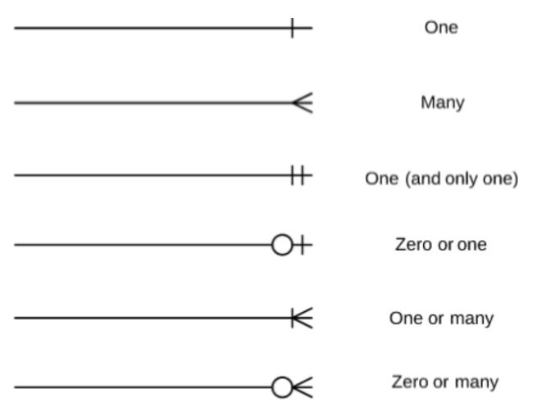
Crow’s Feet Notation
A way of expressing the cardinality of a relationship

Slide 14
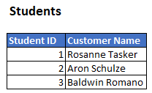
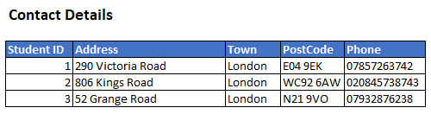
One-to-one
E.g. students and their contact details
Students
Student ID
Student Name
Contact Details
Student ID
Address
Town
PostCode
Phone
“One student will only have one contact details
and
one contact details will only have one student”

Slide 15
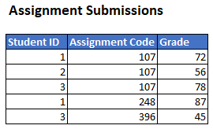
One-to-many
E.g. students and their assignments
Students
Student ID
Student Name
Assignment Submissions
Student ID
Assignment Code
Grade
“One student will have many assignment submissions
and
one assignment submission will only have one student”

Slide 16
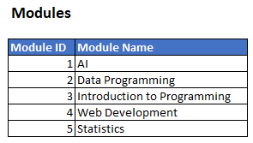
Many-to-many
E.g. students and courses
Students
Student ID
Student Name
Modules
Module ID
Module Name
“One student will have many modules
and
one module will have many students”

Slide 17
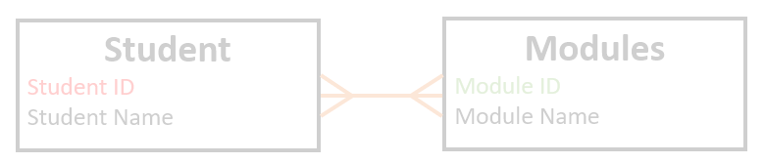
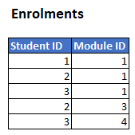
Many-to-many Join Table
We need an additional join table to make many-to-many work
Students
Student ID
Student Name
Enrolments
Student ID
Module ID
Modules
Module ID
Module Name
The enrolments table connects the students and modules tables using foreign keys

Slide 18
SQL
INSERT INTO contact_details (address, town)
VALUES ("290 Victoria Road", "London")
Create = INSERT
Read = SELECT
Update = UPDATE
Delete = DELETE
SELECT first_name, surname
FROM customers
UPDATE products
SET category = "Electronics"
WHERE category = "Elec"
DELETE FROM shops
WHERE country = "Belgium"

Slide 19
SQL JOINS
To SELECT from multiple tables we need a JOIN:
student_id | student_name
1 | Roasanne Tasker
2 | Aron Schulze
3 | Baldwin Romano
4 | Cate Irvine
student_id | address | town | postcode | phone
1 | 290 Victoria Road | London | E04 9EK | 07857263742
2 | 806 Kings Road | London | WC92 6AW | 02084573874
3 | 52 Grange Road | London | N21 9VO | 07932876238
4 | 7 Manor Road | London | N12 6GS | 07829837982
SELECT *
FROM students
JOIN contact_details
ON students.student_id = contact_details.student_id;
student_id | student_name
1 | Roasanne Tasker
2 | Aron Schulze
3 | Baldwin Romano
4 | Cate Irvine
student_id | address | town | postcode | phone
1 | 290 Victoria Road | London | E04 9EK | 07857263742
2 | 806 Kings Road | London | WC92 6AW | 02084573874
3 | 52 Grange Road | London | N21 9VO | 07932876238
4 | 7 Manor Road | London | N12 6GS | 07829837982

Slide 20


ORDER BY (order the results of a SELECT)
SELECT *
FROM students
ORDER BY student_name
SELECT *
FROM students
ORDER BY student_name DESC

Slide 21
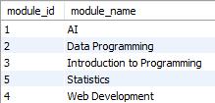



WHERE (conditions for a SELECT)
SELECT *
FROM modules
SELECT *
FROM modules
WHERE module_name = "AI"
SELECT *
FROM modules
WHERE module_name LIKE "%Programming"
SELECT *
FROM modules
WHERE module_name LIKE "%ti%"
% is a wildcard, matches anything

Slide 22
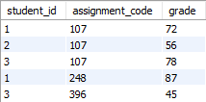


AGGREGATIONS (combine values using a function)
SELECT *
FROM assignment_submissions;
SELECT SUM(grade)
FROM assignment_submissions;
SELECT AVG(grade)
FROM assignment_submissions;

Slide 23

GROUP BY (specify how to group values for aggregations)
SELECT *
FROM assignment_submissions;
SELECT assignment_code, AVG(grade)
FROM assignment_submissions
GROUP BY assignment_code;

Slide 24

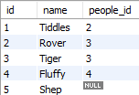

Set-Based Thinking – INNER JOIN
people
pets
1 Tiddles 2
2 Sally
1 Bob
2 Rover 3
3 Fred
3 Tiger 3
5 Shep
4 Meryl
4 Fluffy 4
SELECT *
FROM people
JOIN pets
ON people.id=pets.people_id;

Slide 25
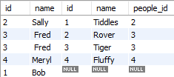
Set-Based Thinking – LEFT JOIN
people
pets
1 Tiddles 2
2 Sally
1 Bob
2 Rover 3
3 Fred
3 Tiger 3
5 Shep
4 Meryl
4 Fluffy 4
SELECT *
FROM people
LEFT JOIN pets
ON people.id=pets.people_id;

Slide 26
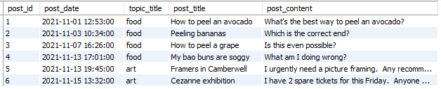
Create a View in MySQL
Take a working query…
SELECT post_id, p.post_date, t.topic_title, p.post_title, p.post_content
FROM posts p
JOIN topics t
ON t.topic_id=p.topic_id
ORDER BY post_date

Slide 27
Create a Stored Proc
Stored procedures are a bit like functions.
DELIMITER //
CREATE PROCEDURE sp_insert_post(
BEGIN
# TODO
END //
DELIMITER ;

Slide 28
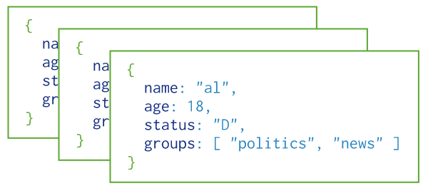
MongoDB: Terminology
Data ‘objects’ represented by documents
Related documents form a collection
Databases house collections
There is no fixed structure to the data in documents

Slide 29


Horizontal Scaling vs. Vertical Scaling
Horizontal scaling (or scale-out) means that you scale by adding more machines into your pool of resources
Vertical scaling (or scale-up) means that you scale by adding more power (CPU, RAM) to an existing machine
With both relational and non-relational databases, vertical scaling is easy but offers limited ability to scale to really big databases.
Horizontal scaling is the to solution to scale to really big databases, but it’s not easy with relational databases.

Slide 30
In Databases and the Web…
Module Overview

Slide 31
Overview
Origins of relational database
NoSQL database variations
Advanced SQL
Security of data in storage and transit
Authentication and authorisation in web apps
Validation and sanitisation in web apps
Password hashing
APIs

Slide 32
Format of the module

Slide 33
Because we missed a week…
I propose
We cover lecture content over 9 lectures
You do lab 1.1 (which is just SQL revision) in your own time
Book time with me if you need help with it
Lab 1 will be zero-weighted
so you don’t have an assessed submission deadline next week

Slide 34
Format of the Module
Lectures,
Mondays 4pm in RHB342
Recorded, available on the VLE by the end of Monday
Theoretical content
Labs
Hands-on building web applications
Labs are compulsory and will be assessed
Either Mondays 2pm or Tuesdays 11am
Self-learning
Reading, watching videos
Most importantly: do some coding yourself

Slide 35
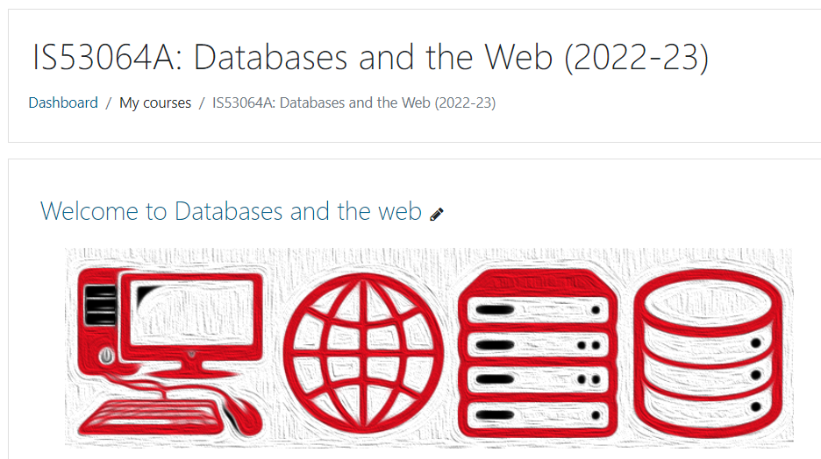
VLE
Should be your one-stop shop for the module
https://learn.gold.ac.uk/course/view.php?id=24790

Slide 36
Labs
Labs are 2 hours each
One per week (10 labs)
Compulsory
Assessed
Give you hands-on experience

Slide 37

Communication
Speak to me, one-2-one
Mondays 11:15 on campus (book on VLE)
By arrangement on Teams (email me to arrange)
Use the forums
Let me know if something isn’t making sense!
I can explain another way, give examples, etc either in the forums or in the next lecture

Slide 38
Module Learning Outcomes
1 | Explain the context behind the relational model
2 | Explain and apply domain attribute tables and enterprise constraints in databases
3 | Devise and explain advanced representation of data in SQL and no SQL DBMS
4 | Explain the steps required to assure database security and integrity
5 | Understand the requirements placed on data aggregators to assure confidentiality and access to personal information
6 | Construct dynamic web applications to perform advanced querying on relational and non-relational databases.
7 | Appraise legal social and ethical considerations of gathering and processing data

Slide 39
Reading List
Database System Concepts, Mc Graw Hill, 2019
https://www.mheducation.com/highered/product/database-systemconcepts-silberschatz-korth/M9780078022159.html
Fundamental of Databases Systems 7th edition, 2016
https://www.amazon.com/Fundamentals-Database-Systems-Ramez-Elmasri/dp/0133970779
Web development with Node.js and Express
https://www.amazon.co.uk/Web-Development-Node-Express-Leveraging/dp/1491949309
Express in Action
https://www.amazon.co.uk/Express-Action-applications-companiontools/dp/1617292427/ref=pd_lpo_sbs_14_t_0?_encoding=UTF8&psc=1&refRID=XKTXPYPXF1FKGSVG54J3

Slide 40
Assessments
50% coursework
4 lab assignments
2 quizzes
1 project
50% exam

Slide 41
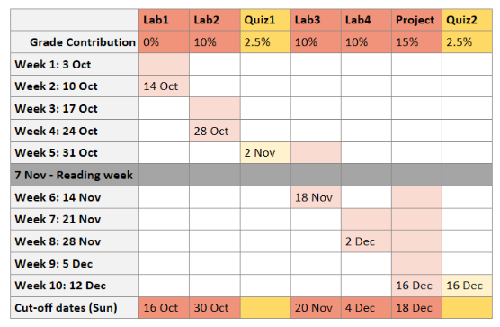
Assessment Schedule
Due dates are Fridays
Missing a deadline will make the next week really hard!

Slide 42
Assessment Rules
Labs
Due dates are Fridays 4pm
Extensions to Sundays 4pm (email me, unless RASA)
Further extensions need extenuating circumstances approval

Slide 43
Assessment Rules
Quizzes
15 mins, 2 attempts
Submit your quizzes by the Wednesdays
No extensions will be given

Slide 44
END OF SLIDES

